Slide 1


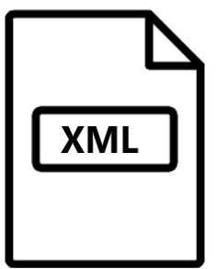

Freeze 3 workflow
Date : september 2022
StartExecutionTime : 21/09/2022 09:43:43
EndExecutionTime : 21/09/2022 12:54:17
4389 genes in orphanet DB (pd6)
RUN solveRD
Hp.obo runSolvedRDAnalysis.jar
Product4_RunSolveRD.xml
6244 json results Case-case(CC) / Case-ORPHA(CO)
b_get_gene_from_orpha.py
6244 cases
439 solved with genes
528 with genes
5655 Orphacodes with 4414 genes (4389+25 gene from pd child)
a_get_gene_from_case.py
en_product6_sep2022.xml
Orpha with HPO
Remove groups of disorders
Orpha child gene or orpha parent genes not both not none
Solved_with_gene_noparents_with_5phenotypes_aftercuration.xlsx
Solved cases with genes
Min 5 HPO
en_product1_sep2022.xmllv
product_ORPHApackets_childs.xml
gene_from_json_case.tsv
From RUN JDBOR
gene_from_solved_case.tsv
pd_1_6_child.tsv
gene_from_json_or_solved_case.tsv
6244 json results
INPUT ALL
OUTPUT
All cases for the step
One tsv file per case for the step
A1 : List of cases available A1 B1 : List of cases available B1
pd_1_6_child.tsv
6244 json results CO or CC
gene_from_json_case.tsv
STEP A1
STEP B1
STEP C1
INPUT
Solved with genes
Json results CO
INPUT
Solved with gene
Json result CC
83506
125+6243
INPUT
List of cases available A1 -> check all json results CO
193 associations
6243 cases
22489
6243
STEP A2
STEP B2
STEP A2
50480
6243
INPUT
Solved with gene
Json result CO
235600 4712
INPUT
Json results from B1
INPUT
List of cases of C1
708204
5888
A1 TIME 0.432 ms A2 TIME 5.253 ms
B1 TIME 5.218 ms B2 TIME 102.6 ms
C1 TIME 993.6 ms C2 TIME 246.1 ms

Slide 2


Freeze 3 workflow
Date : september 2022
4389 genes in orphanet DB (pd6)
script | Cytoscape_all.py | Wikipathway_all_py4cy.py (WK) | Buildjson_all.py
INPUT | All tsv file per case for all steps | Dataframe format cytoscape compatible | Nodetype df Output WK Df variants for each steps
OUTPUT | Dataframe (df) format cytoscape compatible | New cytoscape df with WK info on it | Autocomplete txt file for each cases of each steps Json format for cytoscape JS
TIME ms
TIME ms
TIME ms
c_ get_ALL_nodetype.py
Freeze 3 Process :
a_get_gene_from_case.py
Cf square blue prev page b_get_gene_from_orpha.py Cf square orange prev page
c_ get_ALL_nodetype.py Cf tab above, build df only the cytoscape js app to discriminate nodes
0_set_environment.py create all folder for output files
00_build_homepage.py build the homepage network of the cytoscape js app in tsv format cytoscape compatible and json format cytoscape js compatible
1_stepA2.py
1_stepB1.py
1_stepB2.py
1_stepC1.py
1_stepC2.py Cf green section previous page
2_cytoscape_all.py
3_wikipathway_all_py4cy.py
4_buildjson_all.py
Cf tab above
Run_all_script.py
path_variable.py contain all paths to lauch all the process

Slide 3
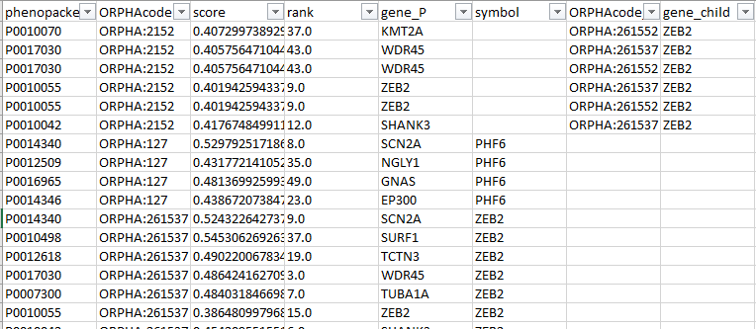
Freeze 3 workflow
Dataframes
First Dataframe output of all steps
LEGEND : phenopacket : Solved Cases Orphacode : Orphacode linked to the solved case Score : value of the egdes interactions depending on the SolveRD algorithme score
Rank : rank of the associations
symbol : genes related to orphacode
Orphacode child : orphacode child
gene_child : gene related to the orphacode child

Slide 4
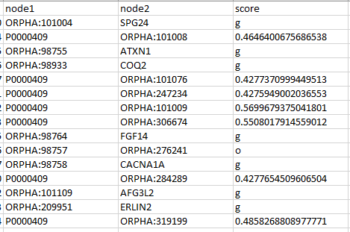
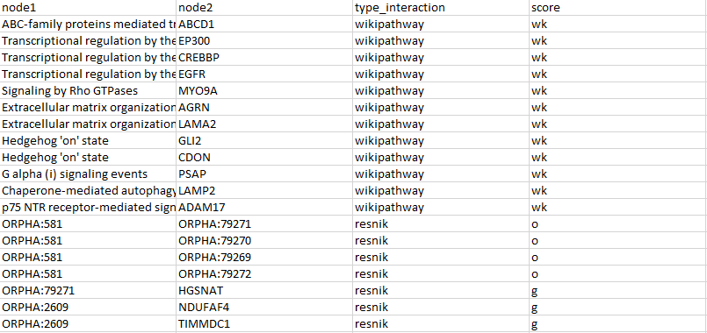
Freeze 3 workflow
Dataframes
Cytoscape df based on the previous df
Add wikipathway info into cytoscape df
LEGEND : node1 : Name of the first node node2 : Name of the node related to node1 Score : value of the egdes interactions depending on the SolveRD algorithme score. o = interaction between orphacode and orphacode child g = interaction between orphacode or cases and gene
LEGEND : type_interaction : add a collunms to know the type of interaction score : wk mean it s a wikipathway interaction

Slide 5
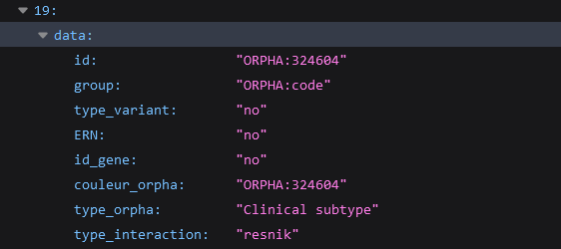
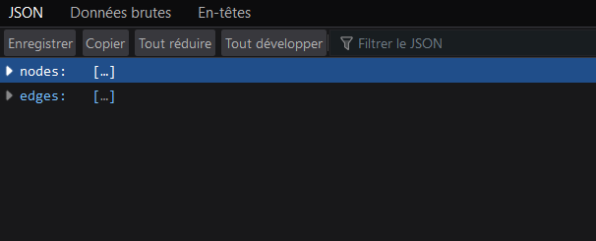
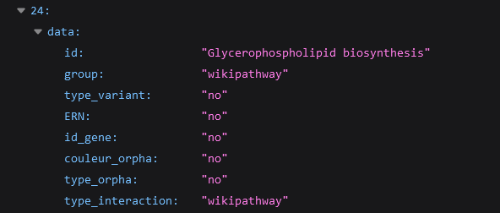
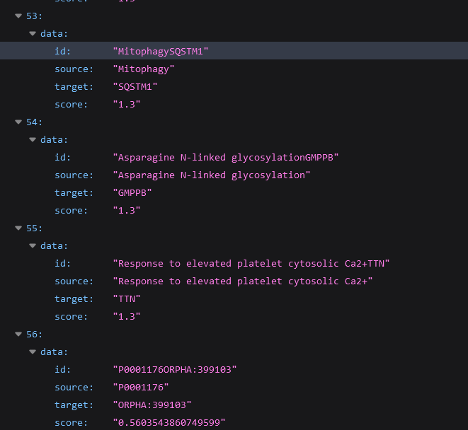
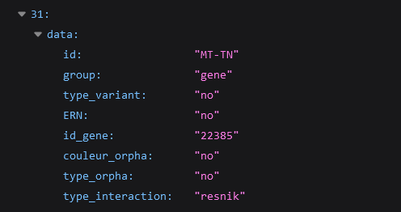
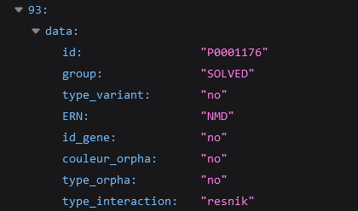
Freeze 3 workflow
Dataframes
Nodes : orphacode data
Json format for cytoscape Js based on the previous wikipathway df
Structure of the json file
Nodes : wikipathway data
Edges
Nodes : gene data
Nodes : phenopacket (solved case) data

